Slide 1
AED INFO 5100 Team – Symphony
Team Members
Sinthu Kumarasamy
Devika Supriya Gadesula
Vinitha Koppula

Slide 2
The Problem
What is the problem?
1. In many areas homeless and underprivileged people do not get proper food, work and health care benefit and several government operated NGO’s are facing huge load of services and supervision issues due to heavy flow of work and with huge amount of budge constraint.
Who has this problem?
2. The state government is facing this problem as the area and problem is huge but the workforce is less and the government cannot afford to more workforce due to budget constraint.
How can the problem be resolved?
3. To reduce the work load of doctors, nurses and supervisors so that their work could be more productive, and they could cover more area and can provide services in effective ways. By this application members can keep track of the contributions received by donors and through events. Work progress is also monitored when the request for help is raised from the administration.

Slide 3
ORGANIZATIONS and SCOPE
The 2 enterpises and 6 organizations who are involved in management of the entire process are:
Contributor Organisation
Contributor
Benificiary
Organisation
Beneficiary
Doctor Organisation
Patient Organisation
Event Organisation
Nurse Organisation
Doctor
Event Manager
Patient
Nurse
Wealth Enterprise
Health Enterprise

Slide 4
Functionalities of Organizations
Contributor Organization:
The different classifications of funds such as food, employment and fund can be added to the organization.
The details of the contributor such name and email will be stored.
After the creation of contribution we can assign a beneficiary who is need to endowment.

Slide 5
Event Organization:
The event manager is responsible for the creation of details of the event and the funds collected.
Beneficiary Organization:
In this the beneficiaries are added based on the help they require. Once a contributor endows fund based on the numerical order help is assigned to them.
Doctor Organization:
If the type of help required for a beneficiary is a doctor consultation based on the availability consultation will be assigned.
Patient Organization:
The patient record is created and status is maintained right from the assignment of doctor consultation until the checkup is completed with lad tests is maintained.
Nurse Organization:
Here the patients assigned the medical tests are taken into consideration and the test will be performed and reverted back to the doctor.

Slide 6
Scope of work
Based on the persons benefited from organization is displayed in the form dashboard. Every person in organization has a work queue for special requests and a particular set of work dedicated to them. Each organization has to perform survey of work done.Each admin and members responsible for particular organization has access to area and can look at the details whenever they want.

Slide 7
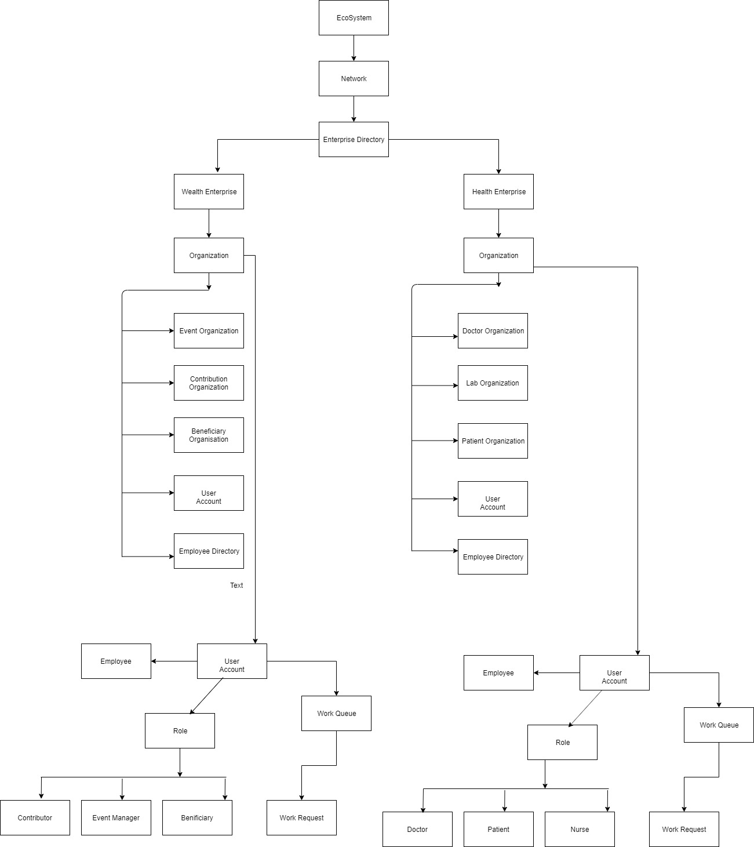
Eco System Architecture

Slide 8
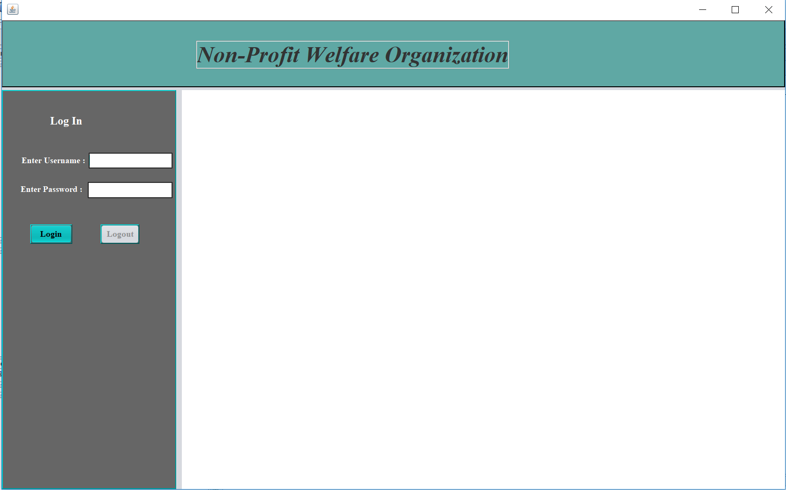
So we have developed this application to streamline the entire process.

Slide 9
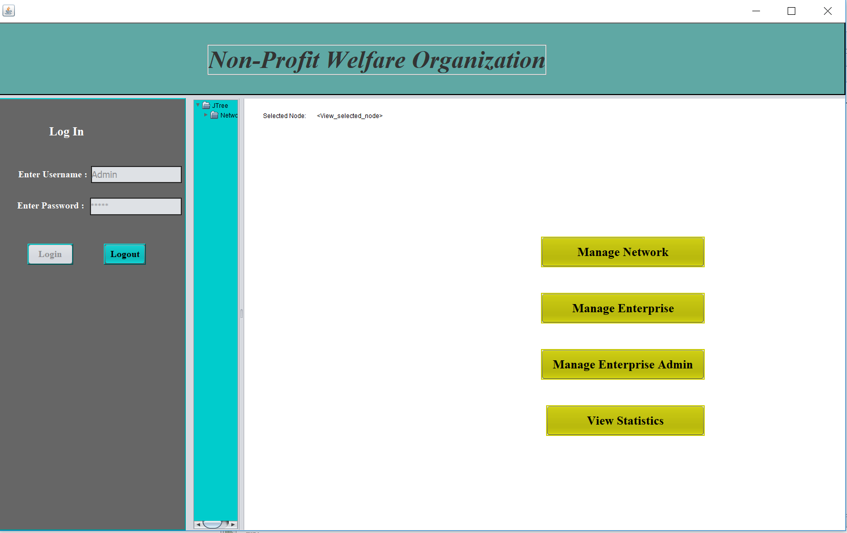
Admin can manage network, enterprise and create enterprise admin

Slide 10
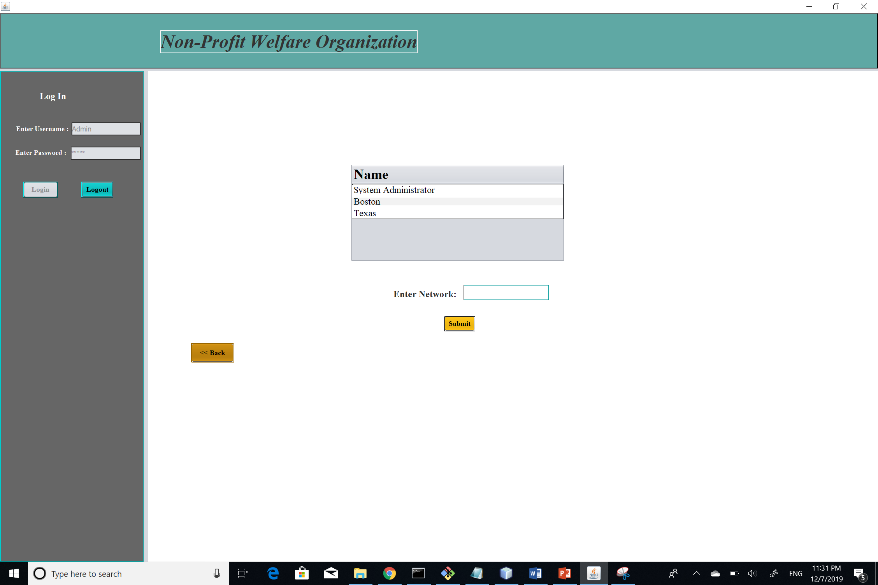
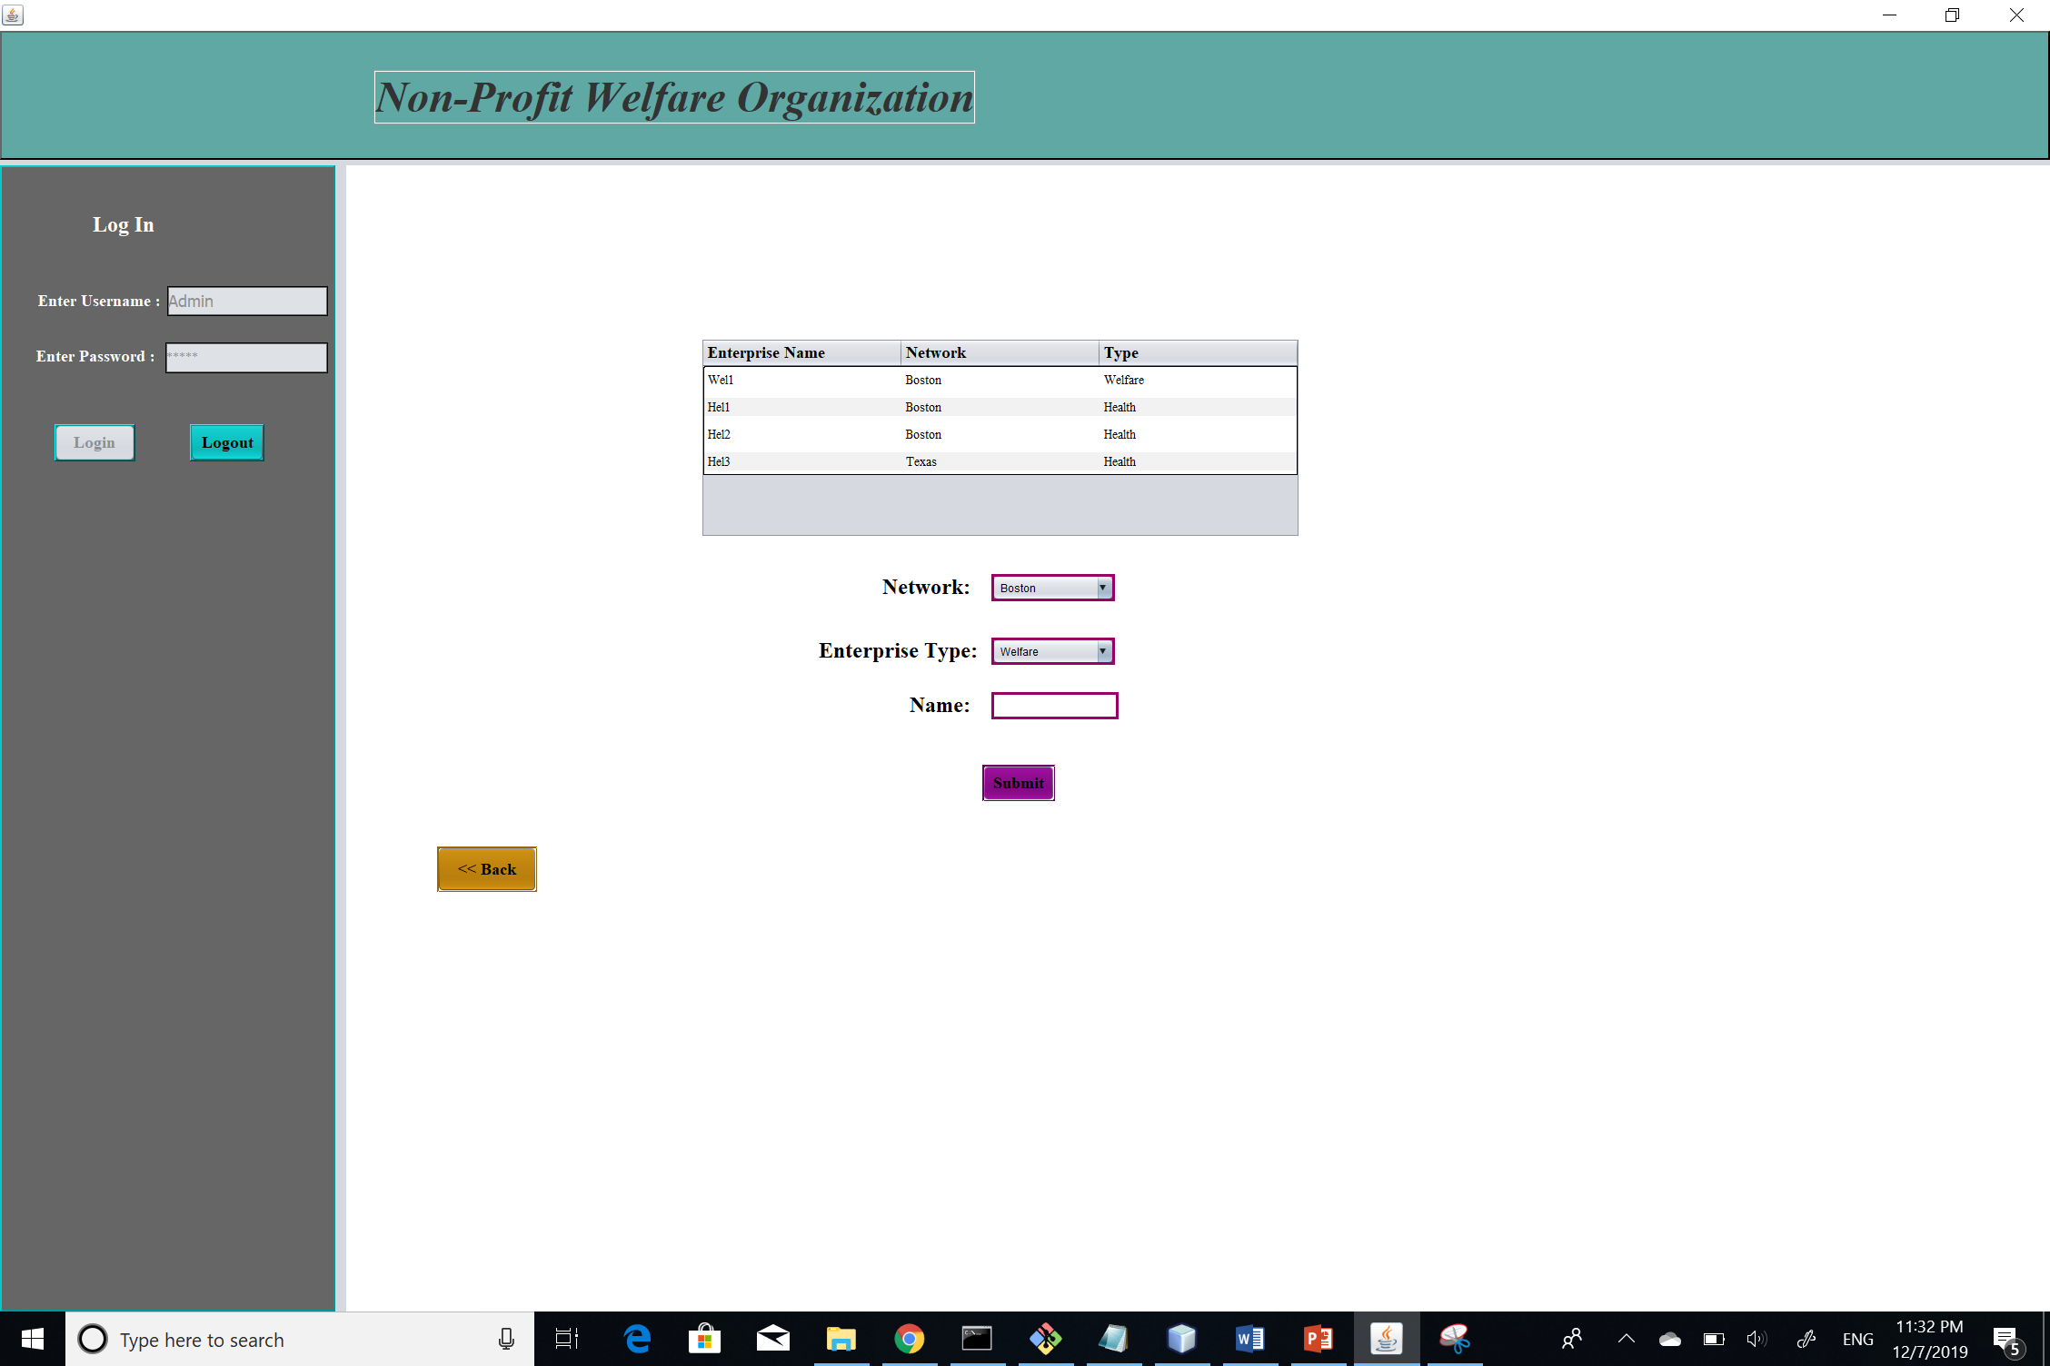
Admin can add network, enterprise and create users

Slide 11
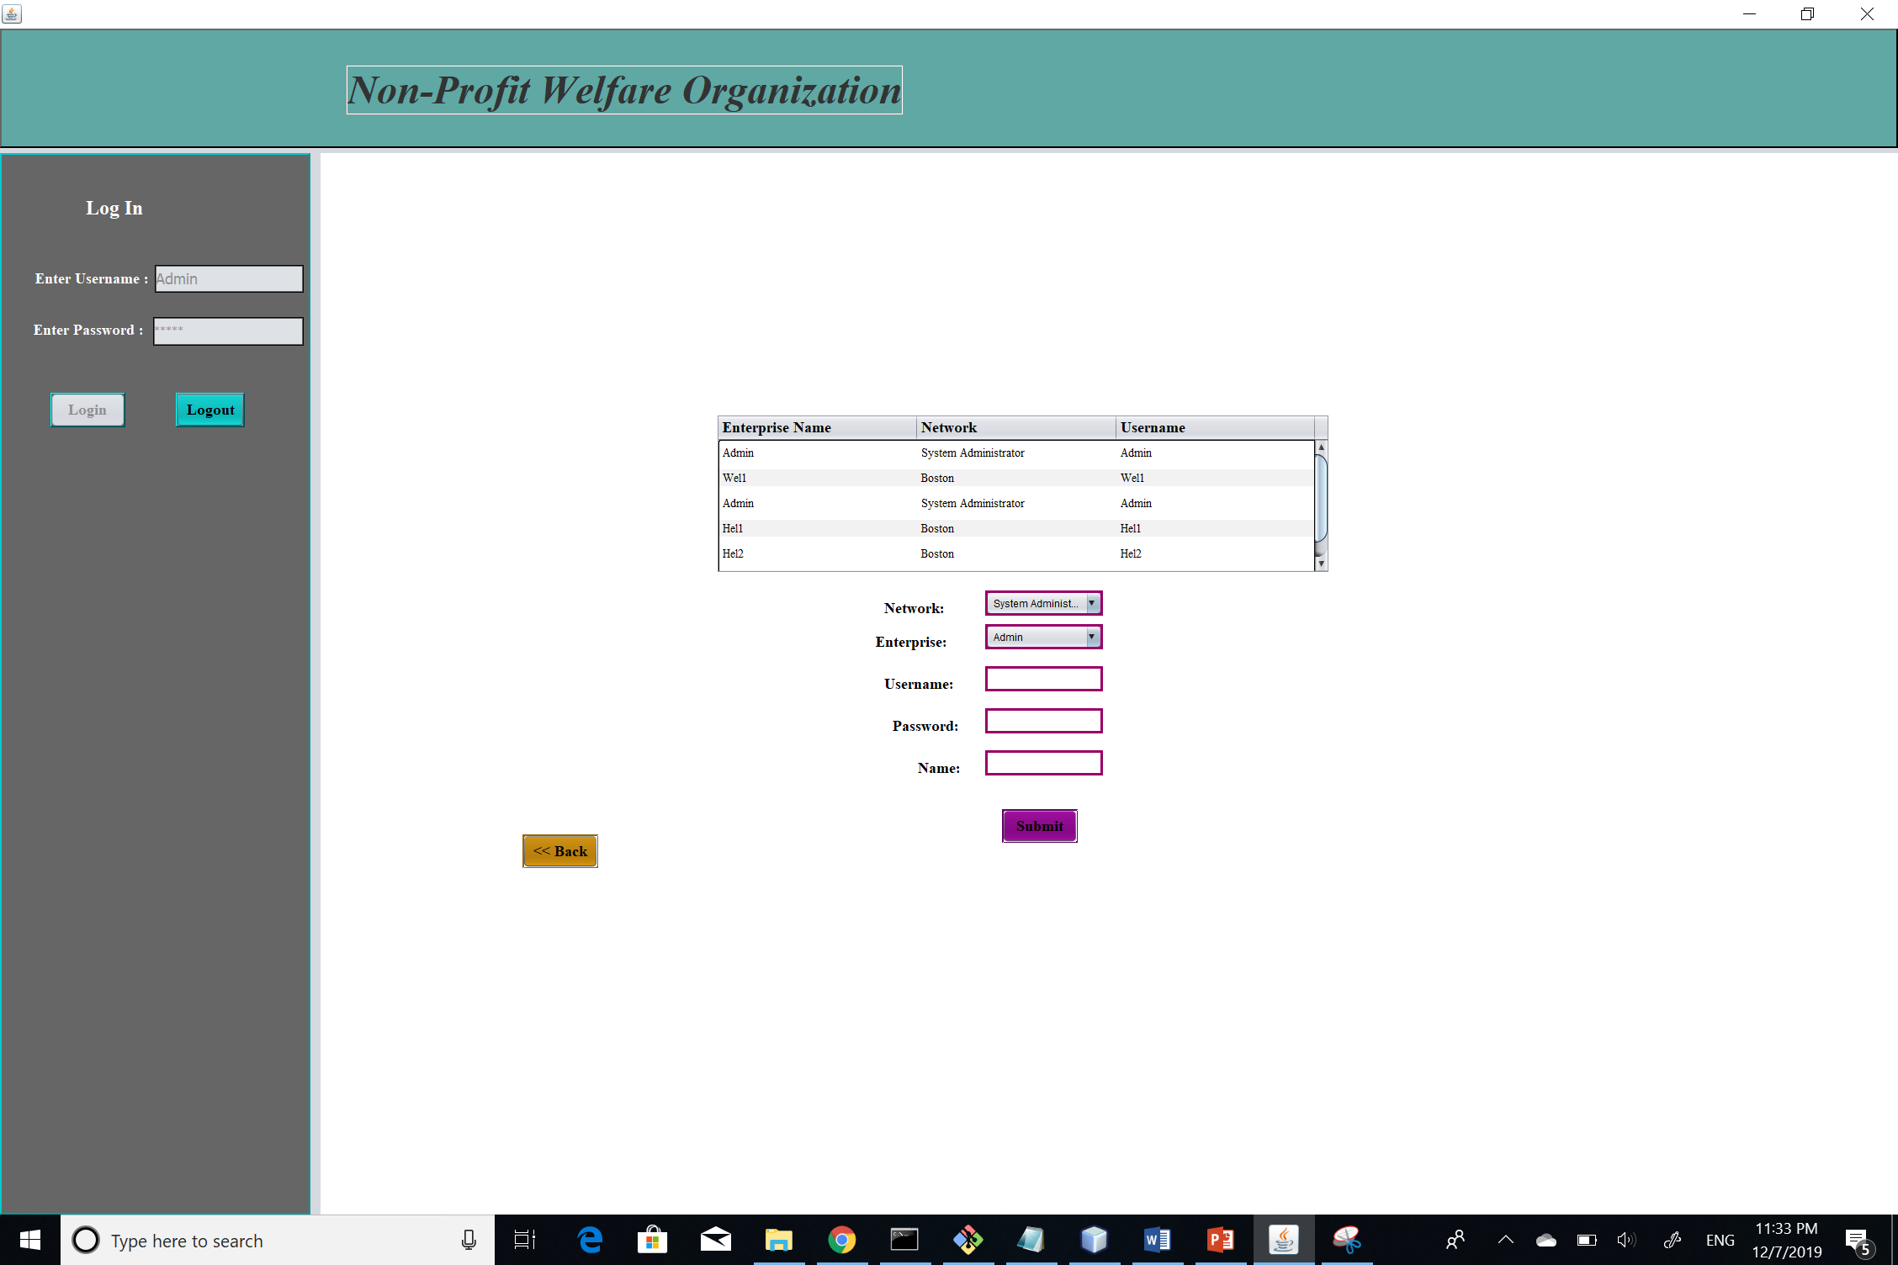

Slide 12
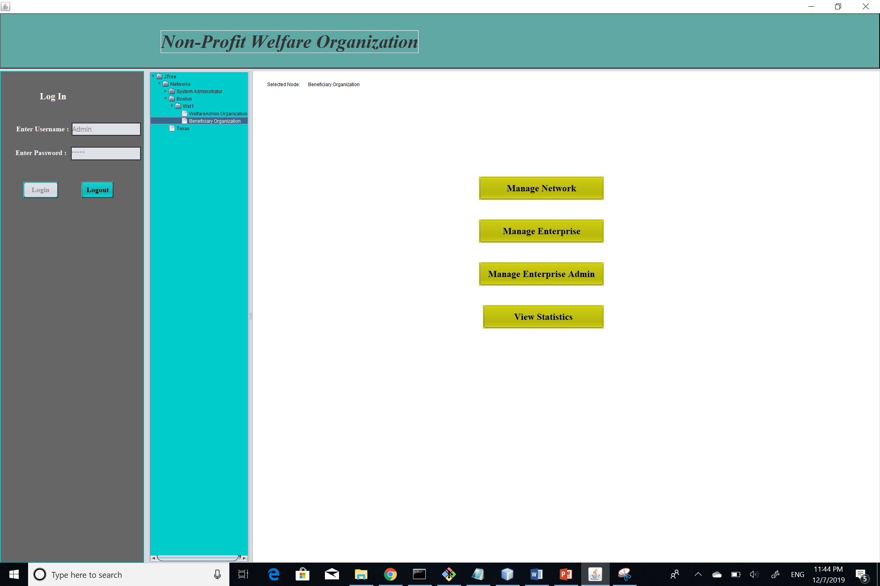
We have implemented JTree feature in the application to track overall network, enterprise and organizations has been created.

Slide 13
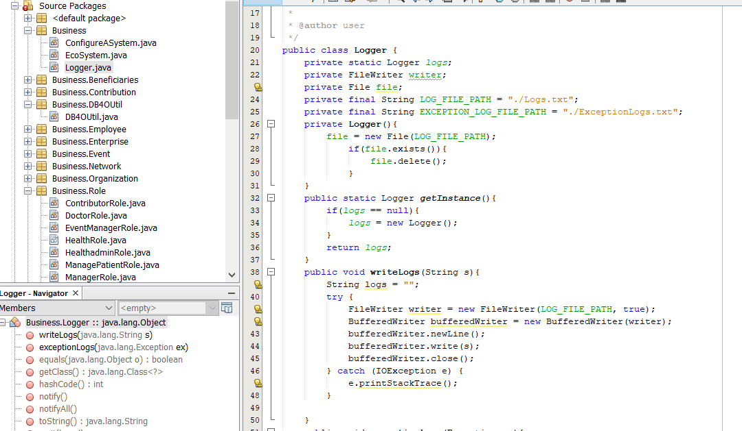
Added logger class to track what actually happening in the system such as User logging and activities and also catch exceptions in the log file.

Slide 14
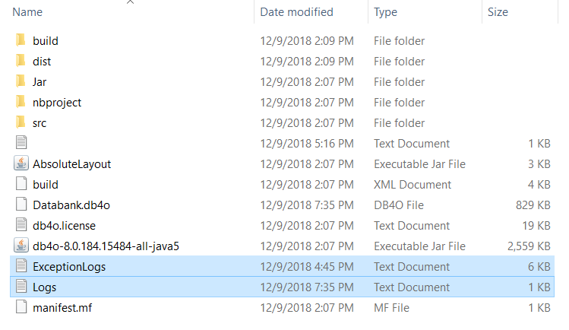
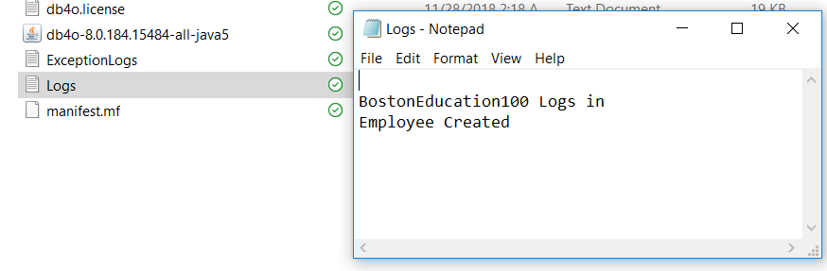
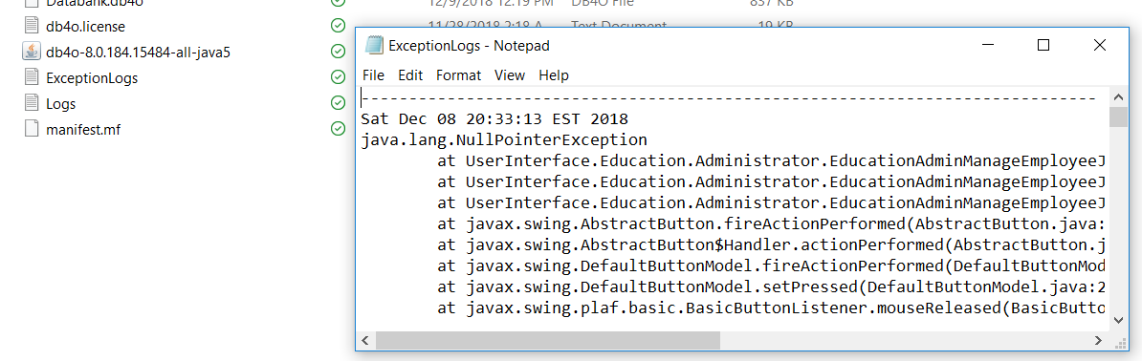
Log files in the system

Slide 15
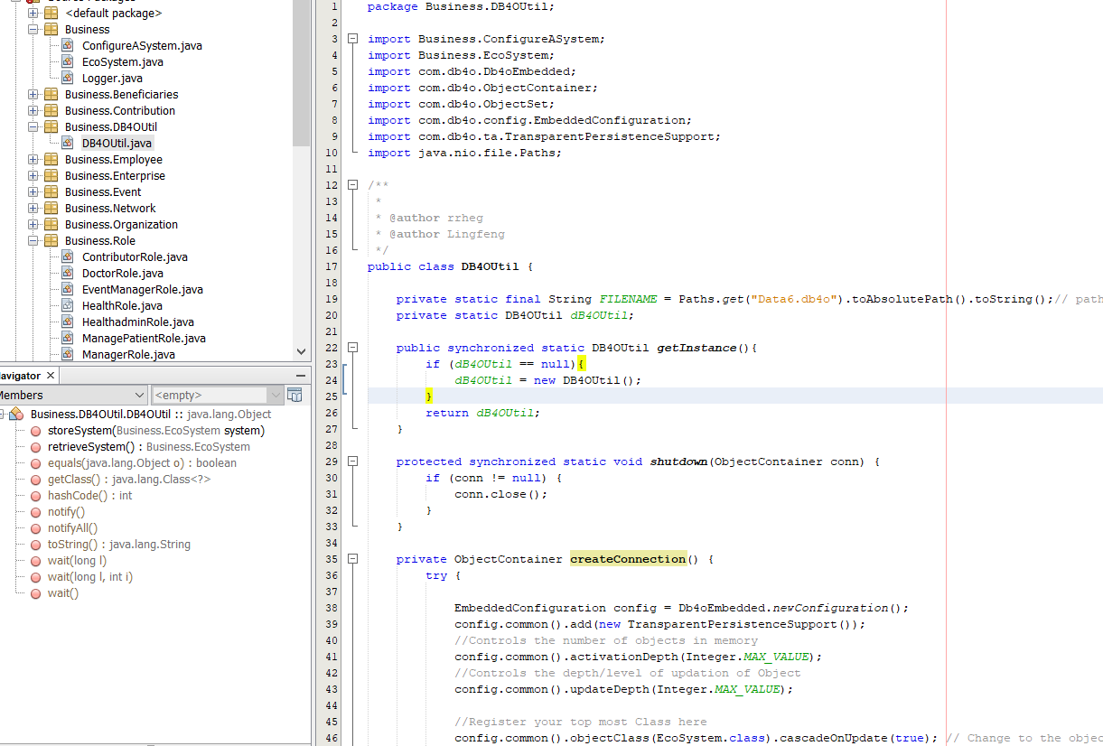
We have used db4o to store data created or used for the application.

Slide 16
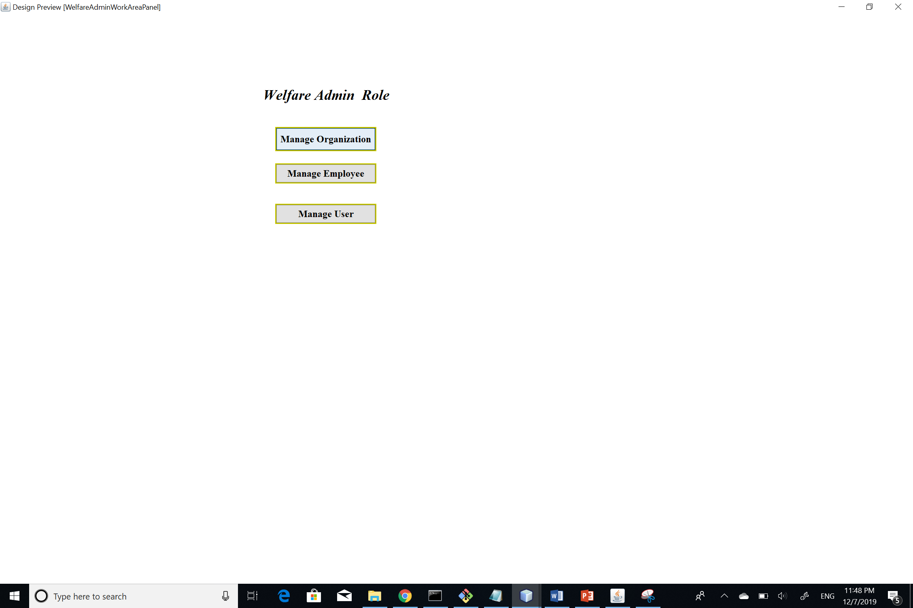
Welfare Admin WorkArea

Slide 17
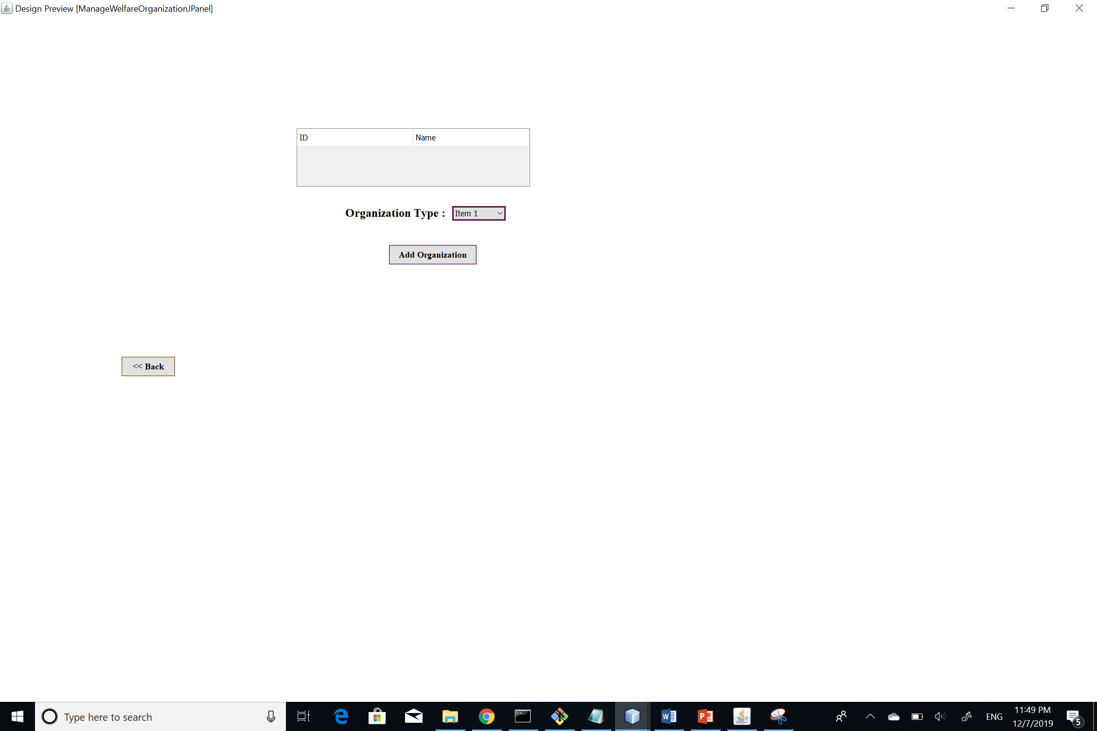
Organisation Creation Jpanel

Slide 18
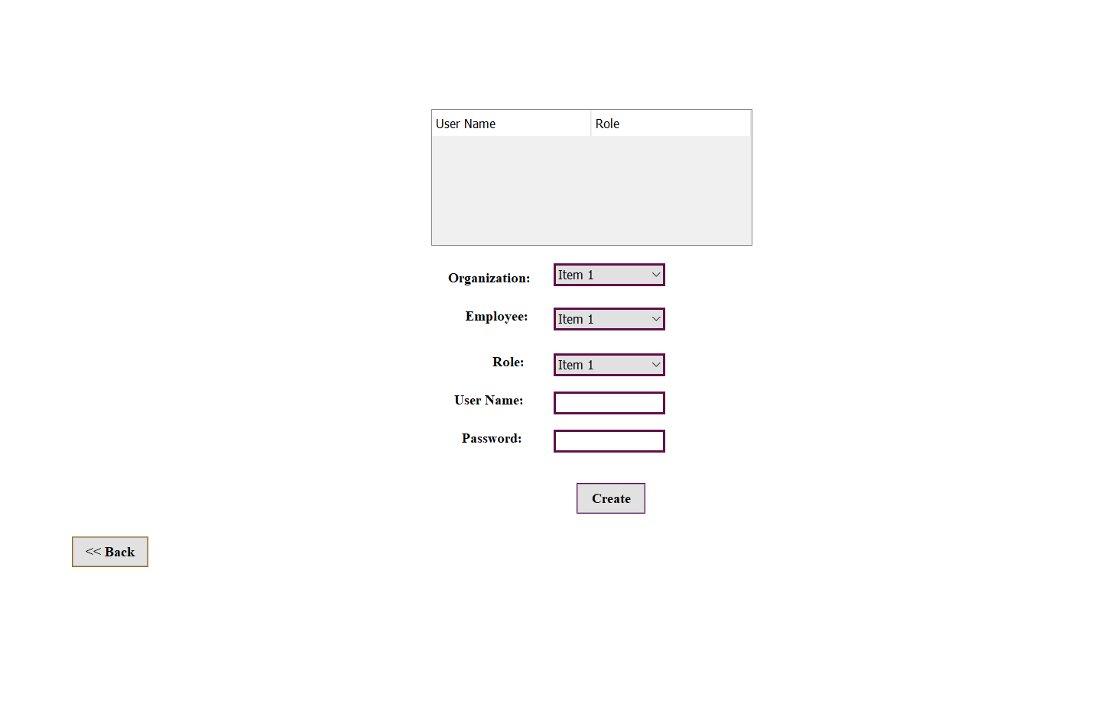
User Creation In Welfare enterprise

Slide 19
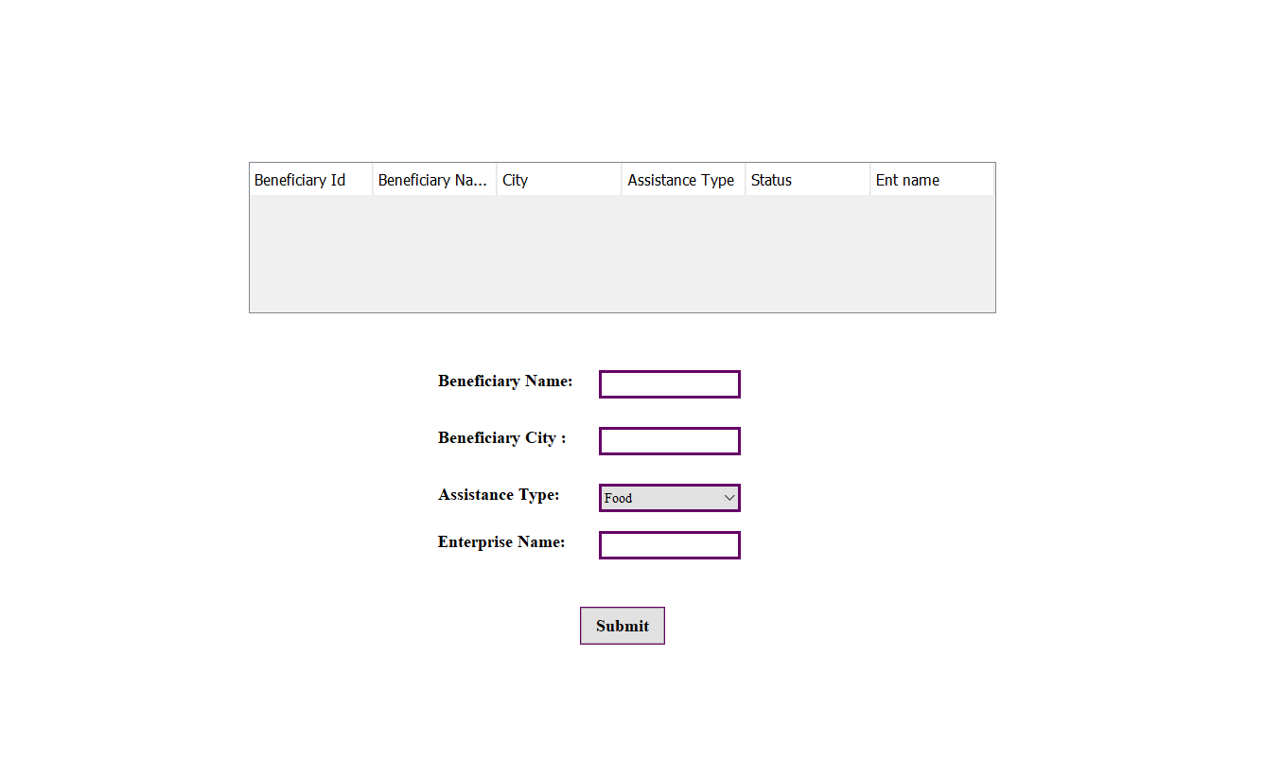
Create benificary JpAnel

Slide 20
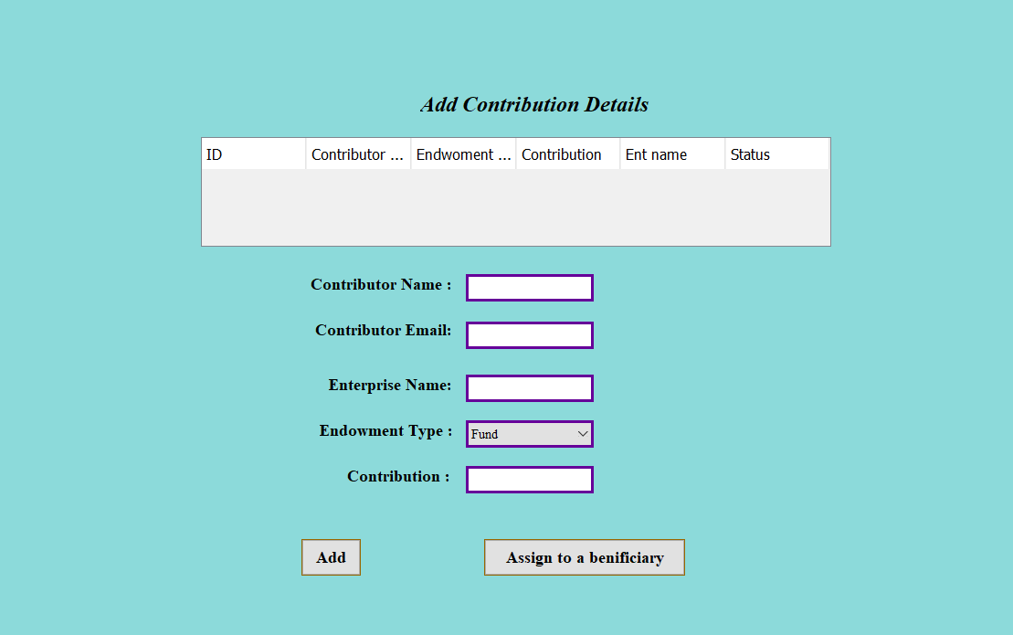
Contributor work Area

Slide 21
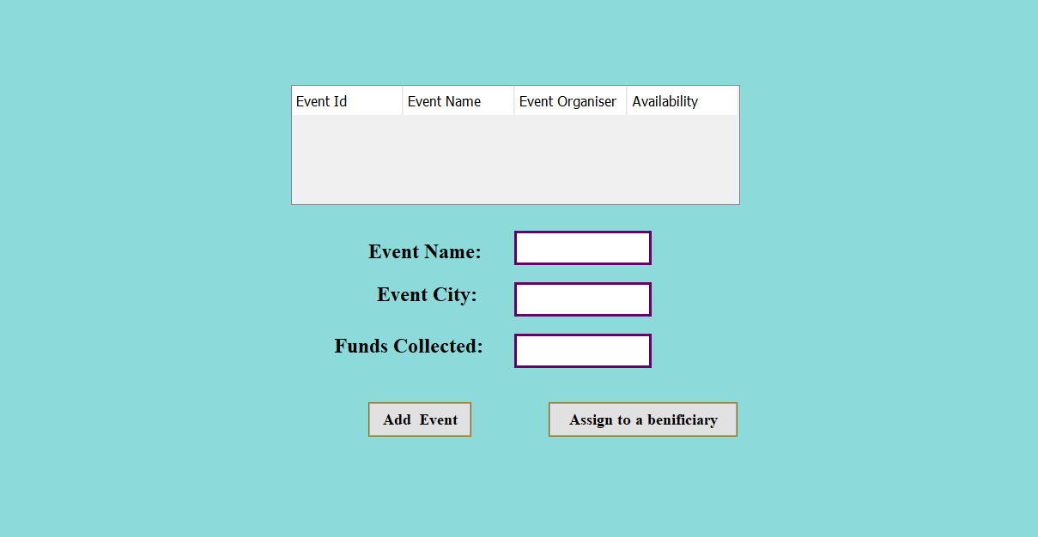
Event manager WorkArea

Slide 22
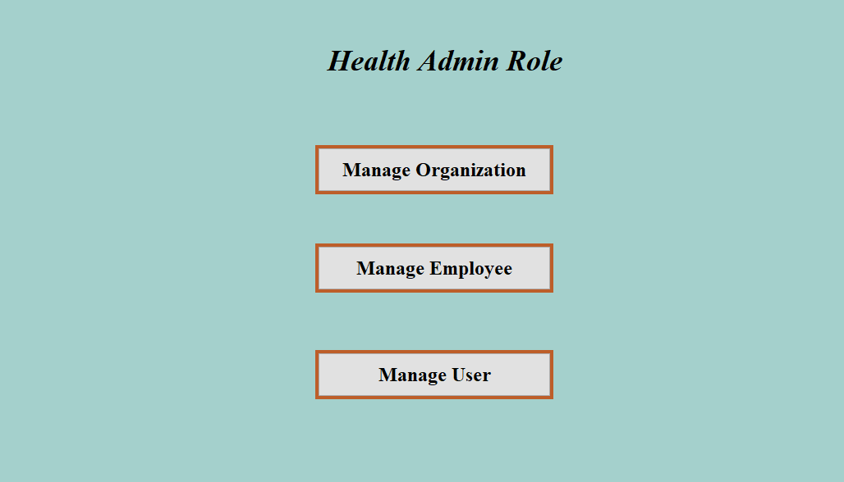
Health Admin Work Area

Slide 23
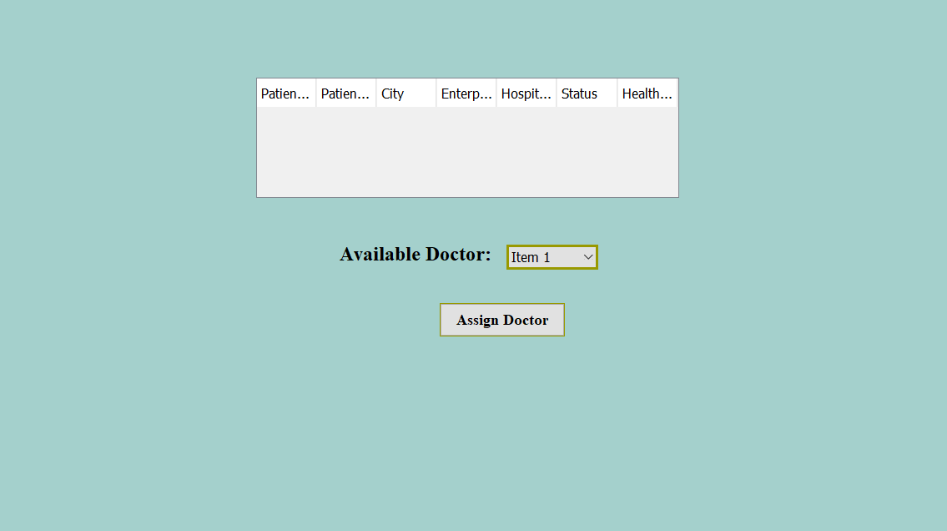
Patient Work Area

Slide 24
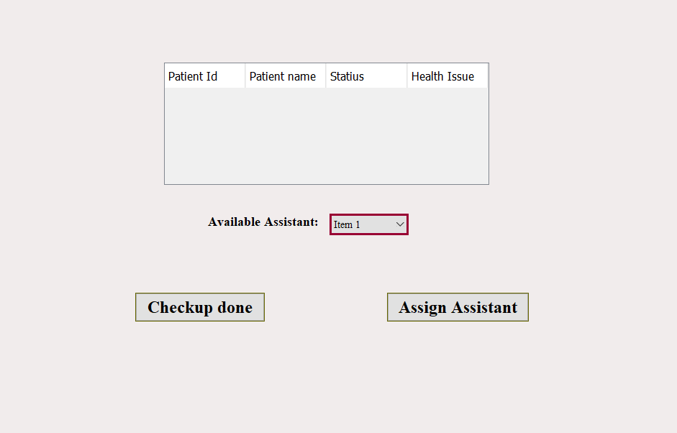
Doctor Work Area

Slide 25
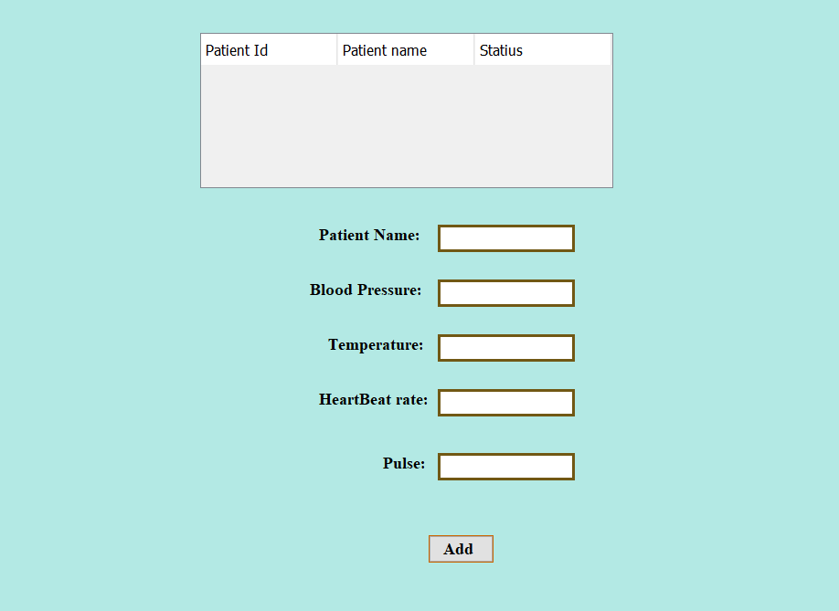
Nurse Work Area

Slide 26
Statistics
We have also added the dashboard with respect to the number of benifiaries benifited from the program

Slide 27
Thank You

